Slide 1
RED BLACK TREES

Slide 2
A balanced binary search tree- Review
Binary Search Tree (BST) is a good data structure for searching algorithm
It supports
Search, find predecessor, find successor, find minimum, find maximum, insertion, deletion
The performance of BST is related to its height h
All the operations are O(h)
We want a balanced binary search tree
Height of the tree is O(log n)
Red-Black Tree is one of the balanced binary search tree

Slide 3
Properties of Red-Black Trees
Every node is either red or black
The root is black
If a node is red, then both its children are black
For each node, all path from the node to descendant leaves contain the same number of black nodes
All path from the node have the same black height

Slide 4
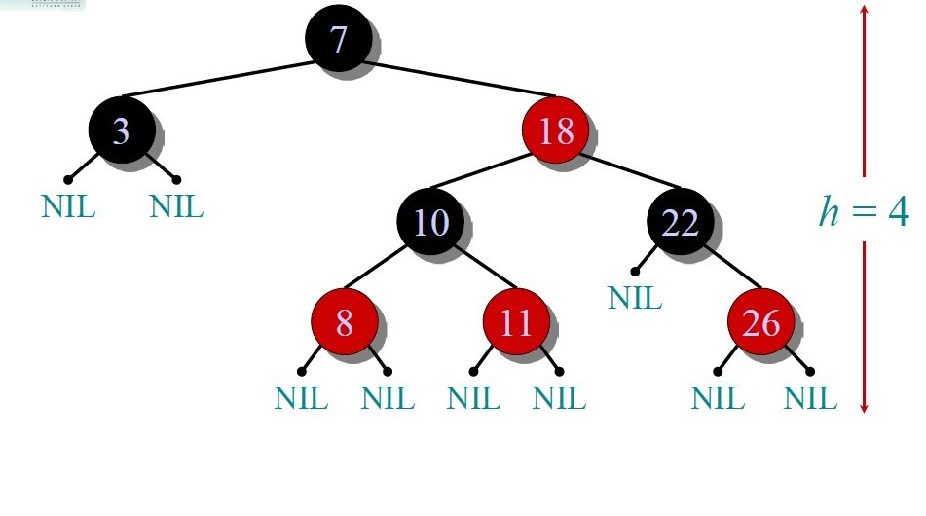

Slide 5
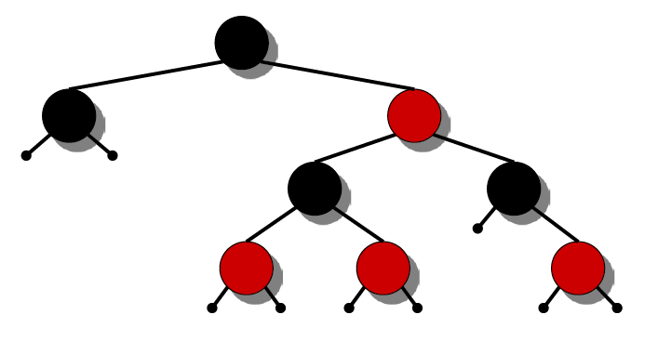
Height of a red-black tree
A red-black tree with n keys has height h ≤ 2 lg(n + 1).
INTUITION:
Merge red nodes into their black parents.

Slide 6
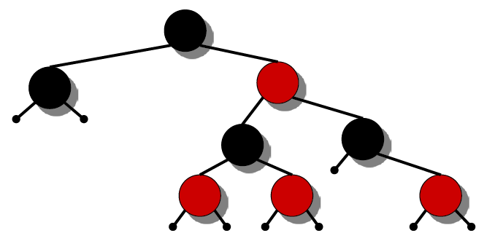
Height of a red-black tree
A red-black tree with n keys has height h ≤ 2 lg(n + 1).
INTUITION:
Merge red nodes into their black parents.

Slide 7
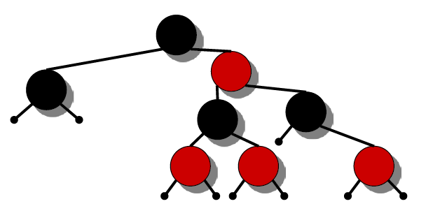
Height of a red-black tree
A red-black tree with n keys has height h ≤ 2 lg(n + 1).
INTUITION:
Merge red nodes into their black parents.

Slide 8
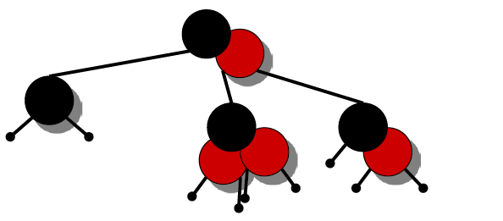
Height of a red-black tree
A red-black tree with n keys has height h ≤ 2 lg(n + 1).
INTUITION:
Merge red nodes into their black parents.

Slide 9
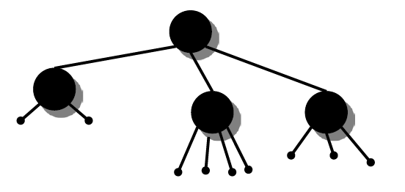
Height of a red-black tree
A red-black tree with n keys has height h ≤ 2 lg(n + 1).
INTUITION:
Merge red nodes into their black parents.

Slide 10
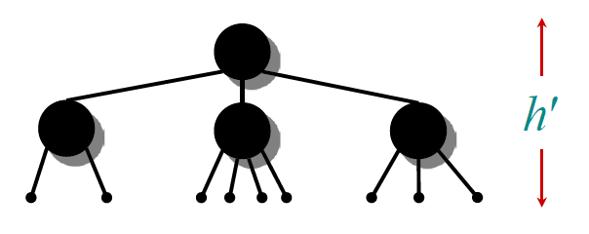
Height of a red-black tree
A red-black tree with n keys has height h ≤ 2 lg(n + 1).
INTUITION:
Merge red nodes into their black parents.
This process produces a tree in which each node has 2, 3, or 4 children.
The 2-3-4 tree has uniform depth h′ of leaves.

Slide 11

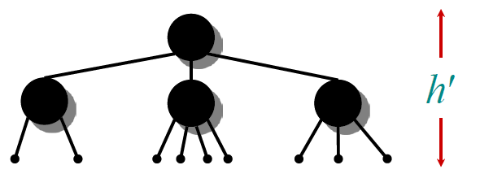
Height of a red-black tree
We have h′ ≥ h/2, since at most half the leaves on any path are red.
The number of nodes in each tree is n + 1 ⇒ n + 1 ≥ 2h' ⇒ lg(n + 1) ≥ h' ≥ h/2 ⇒ h ≤ 2 lg(n + 1).
The queries SEARCH, MIN, MAX, SUCCESSOR, and PREDECESSOR all run in O(lg n) time on a red-black tree with n nodes.

Slide 12
Modifying operations
The operations INSERT and DELETE cause modifications to the red-black tree:
the operations causes violation of the red-black properties
Colour of some nodes to be changed
restructuring the links of the tree via “rotations”.

Slide 13
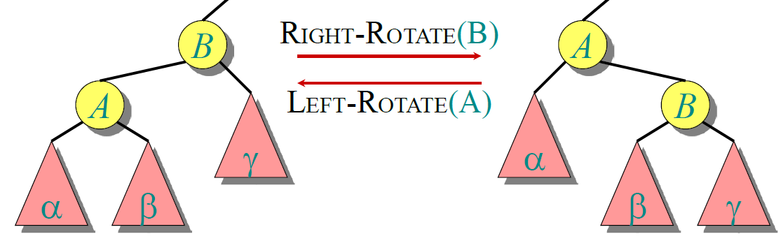
Rotations
Rotations maintain the in-order ordering of keys:
a ∈ α, b ∈ β, c ∈ γ ⇒ a ≤ A ≤ b ≤ B ≤ c.
A rotation can be performed in O(1) time.

Slide 14
Rotations
Left Rotate (T, A) pseudocode
B=A.right
A.right=B.left
If B.left≠T.nil
B.left.p=A
B.p=A.p
If A.p==T.nil
T.root=B
Elseif A==A.p.left
A.p.left=A
Else A.p.right=B
B.left=A // A on B’s Left
A.p=B

Slide 15
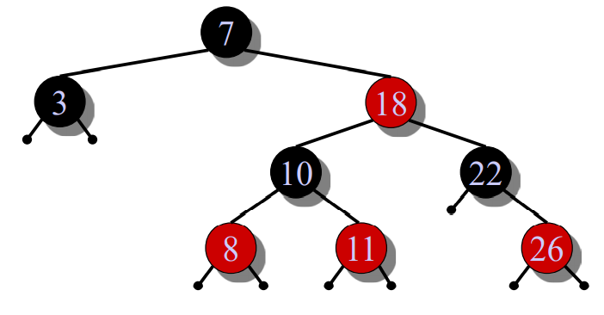
Insertion into a red-black tree
IDEA:
Insert x in tree. Color x red. Only redblack property 3 might be violated. Move the violation up the tree by recoloring until it can be fixed with rotations and recoloring

Slide 16
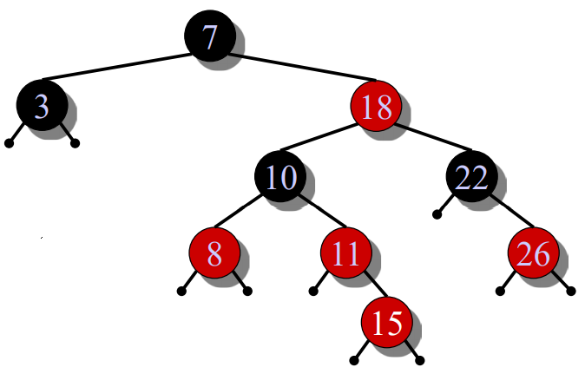
Insertion into a red-black tree
IDEA:
Insert x in tree. Color x red. Only redblack property 3 might be violated. Move the violation up the tree by recoloring until it can be fixed with rotations and recoloring
Example:
Insert x =15.

Slide 17
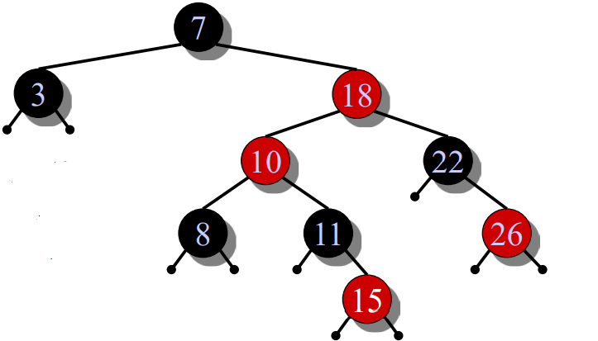
Insertion into a red-black tree
IDEA:
Insert x in tree. Color x red. Only redblack property 3 might be violated. Move the violation up the tree by recoloring until it can be fixed with rotations and recoloring
Example:
Insert x =15.
Recolor, moving the violation up the tree.
RIGHT-ROTATE(18).

Slide 18
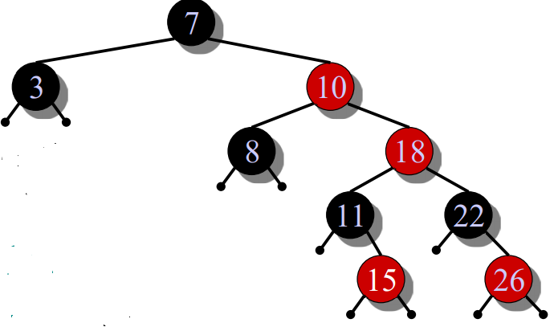
Insertion into a red-black tree
IDEA:
Insert x in tree. Color x red. Only redblack property 3 might be violated. Move the violation up the tree by recoloring until it can be fixed with rotations and recoloring
Example:
Insert x =15.
Recolor, moving the violation up the tree.
RIGHT-ROTATE(18).
LEFT-ROTATE(7) and recolor.

Slide 19
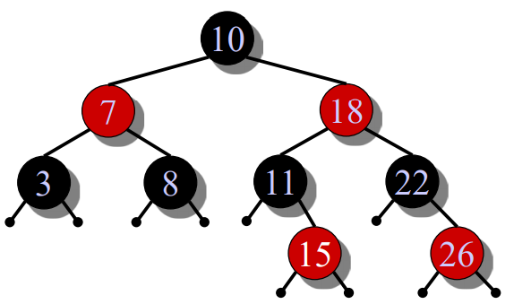
Insertion into a red-black tree
IDEA:
Insert x in tree. Color x red. Only redblack property 3 might be violated. Move the violation up the tree by recoloring until it can be fixed with rotations and recoloring
Example:
Insert x =15.
Recolor, moving the violation up the tree.
RIGHT-ROTATE(18).
LEFT-ROTATE(7) and recolor.

Slide 20
Insertion into a red-black tree- Pseudocode
RB-INSERT(T, x)
TREE-INSERT(T, x)
color[x] ← RED //only RB property 3 can be violated
while x ≠ root[T] and color[p[x]] = RED
do if p[x] = left[p[p[x]]
then y ← right[p[p[x]] // y = aunt/uncle of x
if color[y] = RED
then 〈Case 1〉
else if x = right[p[x]]
then 〈Case 2〉 // Case 2 falls into Case 3
〈Case 3〉
else 〈“then” clause with “left” and “right” swapped〉
color[root[T]] ← BLACK

Slide 21
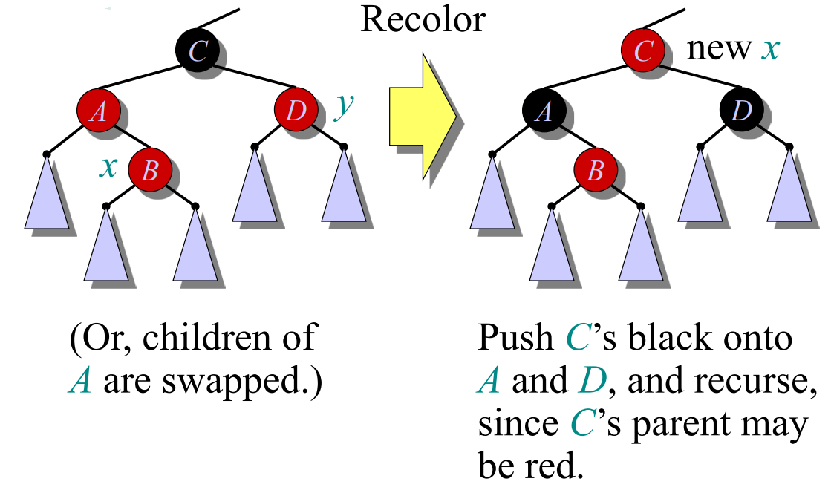
Insertion into a red-black tree- Case-1

Slide 22
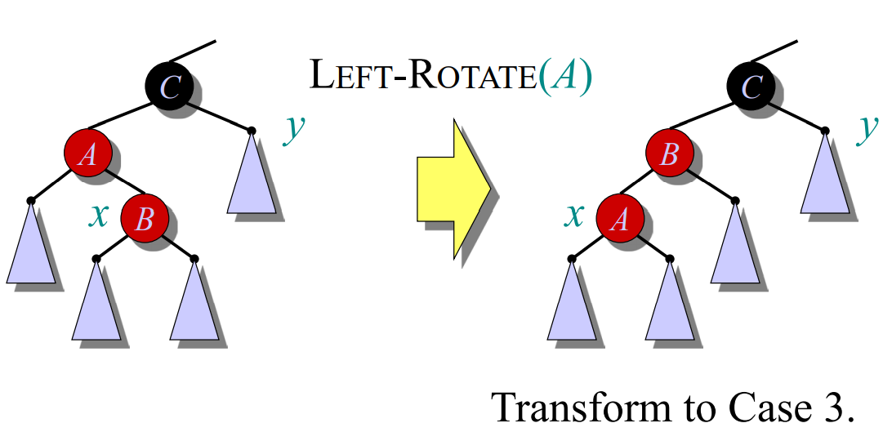
Insertion into a red-black tree- Case-2

Slide 23
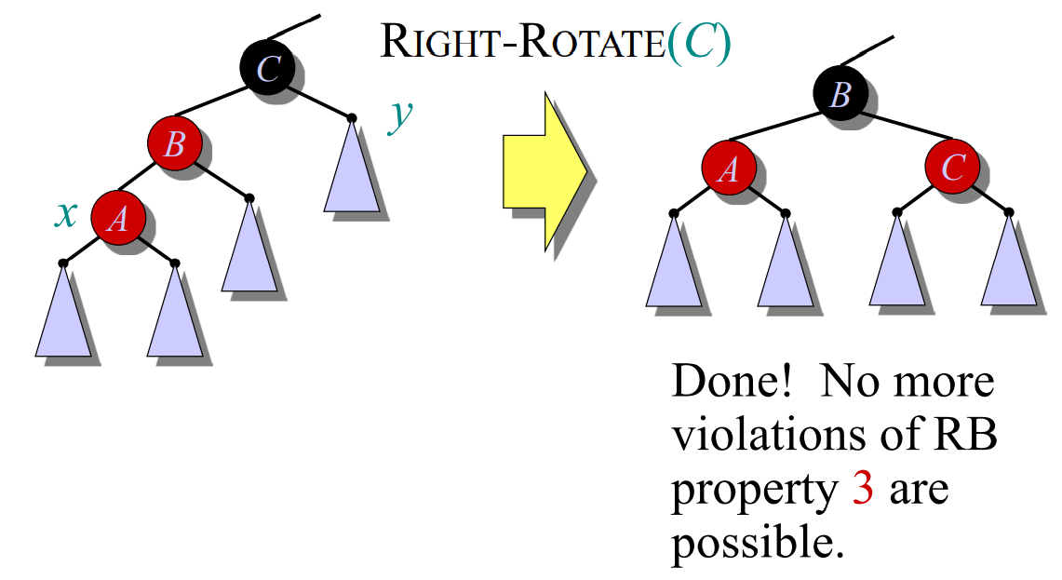
Insertion into a red-black tree- Case-3

Slide 24
Analysis
Go up the tree performing Case 1, which only recolors nodes.
If Case 2 or Case 3 occurs, perform 1 or 2 rotations, and terminate.
Running time: O(lg n) with O(1) rotations.
RB-DELETE — same asymptotic running time and number of rotations as RB-INSERT

